Slide 1

Detection of HealthCare Provider Fraud
UNIVERSITY OF MARYLAND BALTIMORE COUNTY
Submitted By: Lubna Shereen
Professor: Dr. Chaojie Wang

Slide 2
CONTENTS
What is HealthCare Fraud?
Business Problem
Dataset
Exploratory Data Analysis
Data Pre-Processing
Merging all datasets
Machine Learning Models
Results of all Models
Results of Hyper Tuned Models
StreamLit Application
Future Works
References

Slide 3
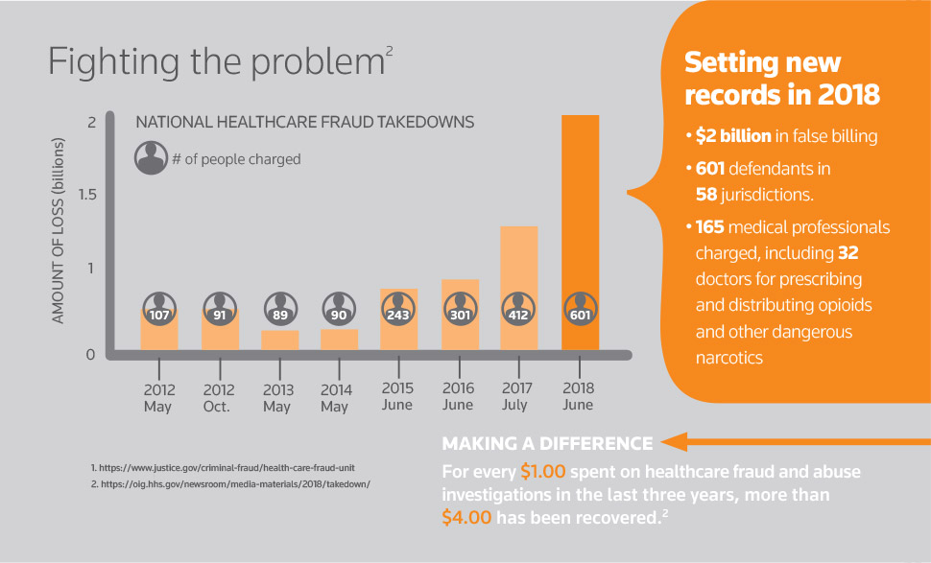
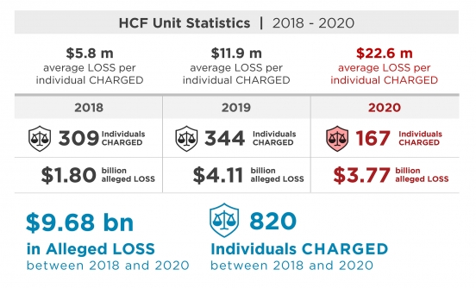
HealthCare Fraud
"Healthcare Provider Fraud," in which the provider completes all the information and submits a claim on the beneficiary's behalf. One of the main issues that Medicare is now dealing with is provider fraud.
There are numerous types of healthcare fraud and abuse. The following are some of the most typical types of provider fraud:
a) Billing for services that were not rendered.
b) Submitting a claim for the same service more than once.
c) Falsely portraying the assistance rendered.
There has been a fraud of $9.68 bn in just last three years.

Slide 4
BUSINESS PROBLEM
Huge loss to the insurance companies. As they need to pay the claims within 30 days as per US Legislation and have little time to look into false claims.
Also due to this fraud, the Government services such as Medicare do not reach out to those who deserve it.
Government also incurs losses by fulfilling the false claims provided by physicians, providers.
Increase in health insurance premiums every year

Slide 5
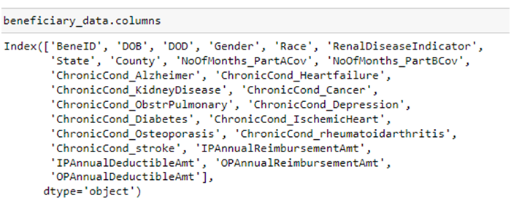
Dataset
The Dataset is given on Kaggle's website. Please find the link below:
https://www.kaggle.com/datasets/rohitrox/healthcare-provider-fraud-detection-analysis
There are four Datasets and below is the brief explanation about all of them:
Beneficiary Dataset: These details include the
beneficiary's DOB, DOD, gender, race, and any
chronic illness they may have as well as their state
and county of residence.
Beneficiary Dataset

Slide 6
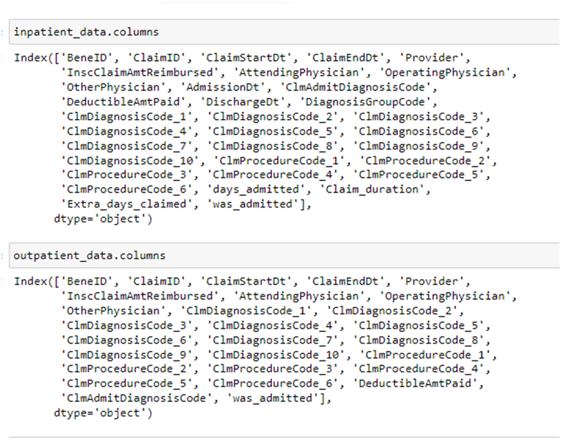
Contd..
2. Inpatient Dataset: The claim information for the patients who were admitted to the hospital is included in it. Thus, it has three additional columns. Dates of admission, release, and diagnosis group code.
3. Outpatient Dataset: It includes the claim information for patients who just paid visits to the hospital and were not admitted.
Inpatient and Outpatient Dataset

Slide 7
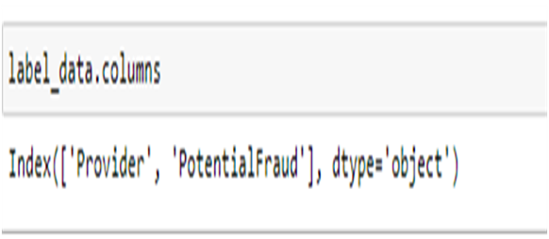

CONTD..
4. Target Dataset/provider dataset: It has provider ID's labelled as potential fraud or not.

Slide 8
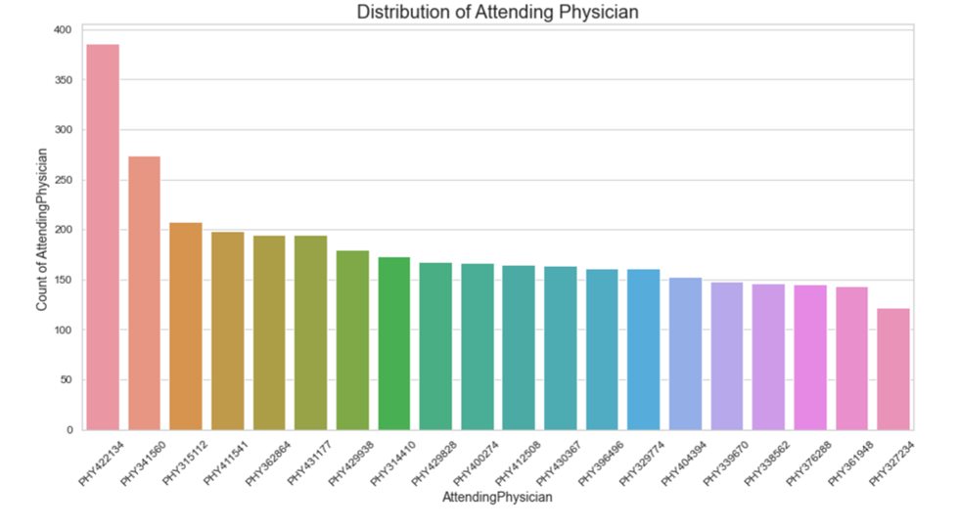
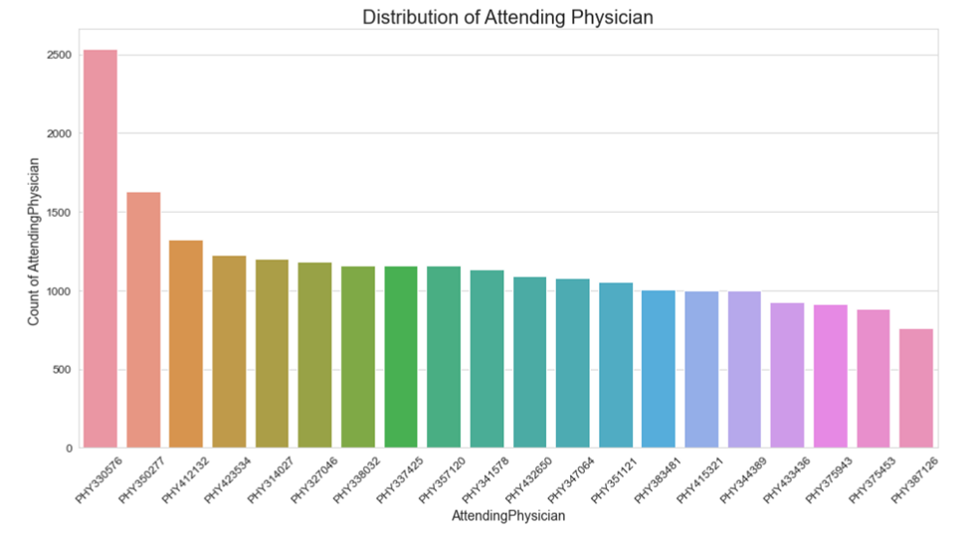
EXPLORATORY DATA ANALYSIS
Inpatient Attending Physician
Out Patient Attending Physician

Slide 9
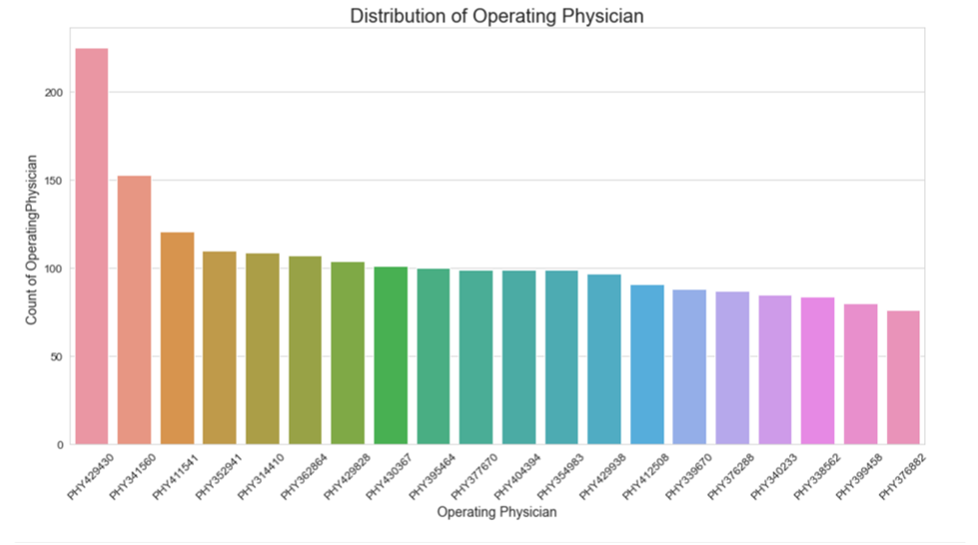
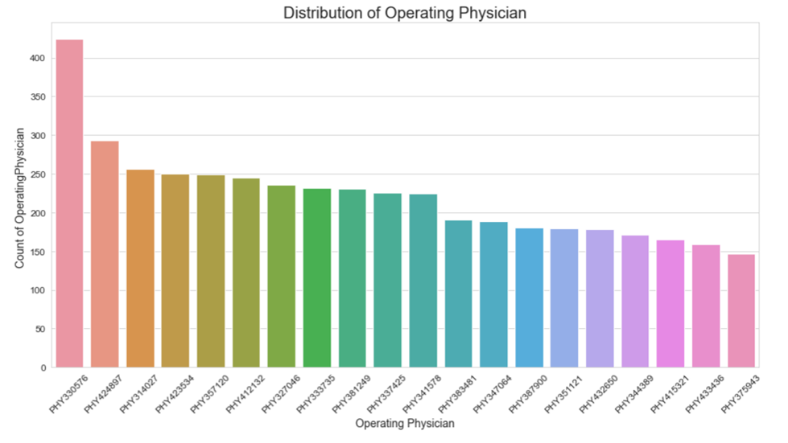
CONTD..
Inpatient Operating Physician
Out Patient Operating Physician

Slide 10
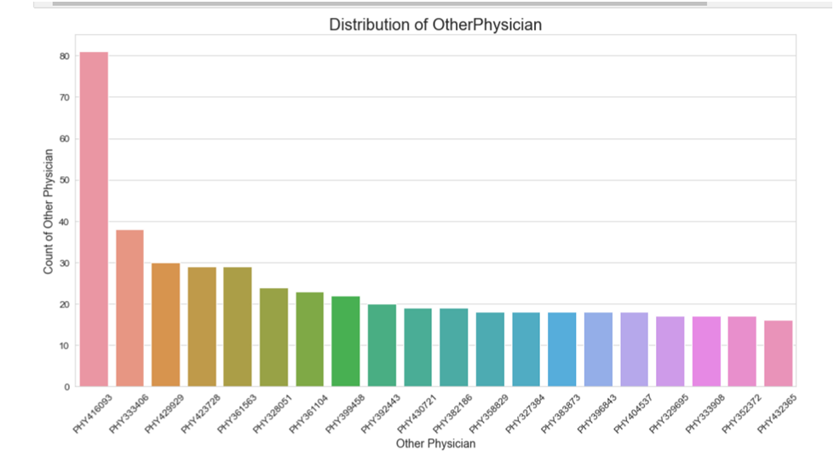
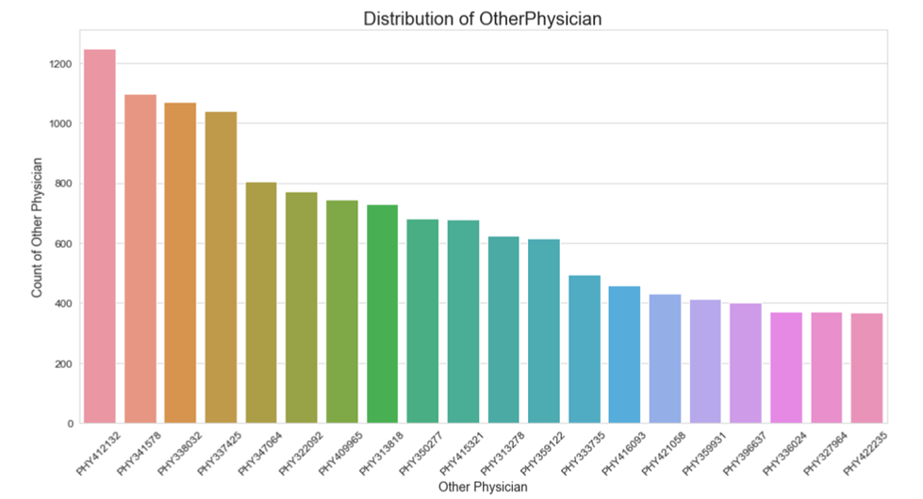
Contd..
Inpatient Other Physician
Out Patient Other Physician

Slide 11
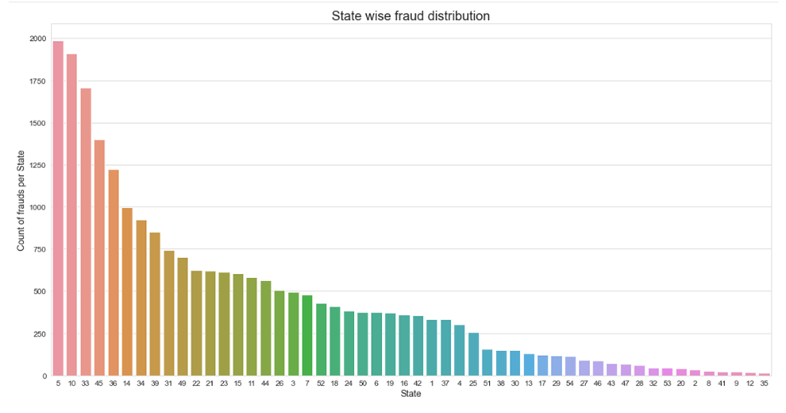
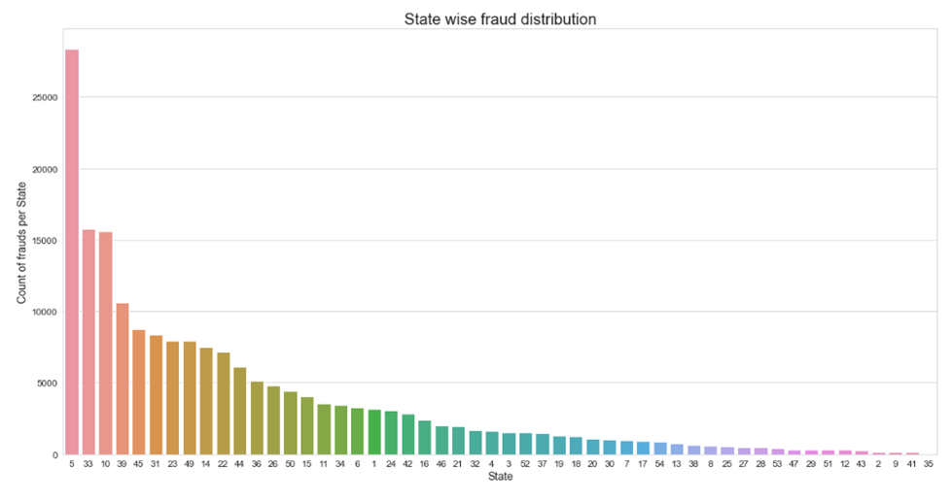
Contd..
Inpatient state wise fraud distribution
Out Patient state wise fraud distribution

Slide 12
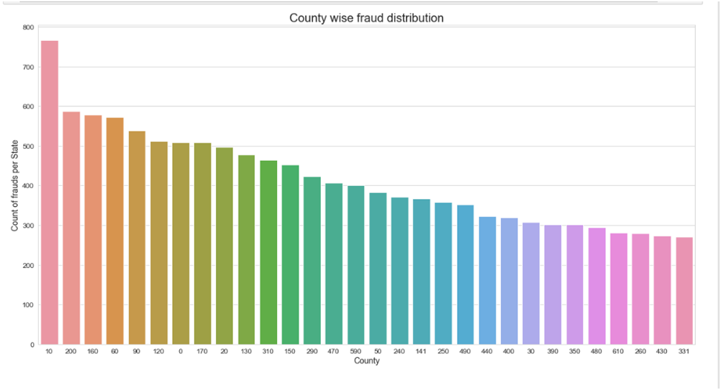
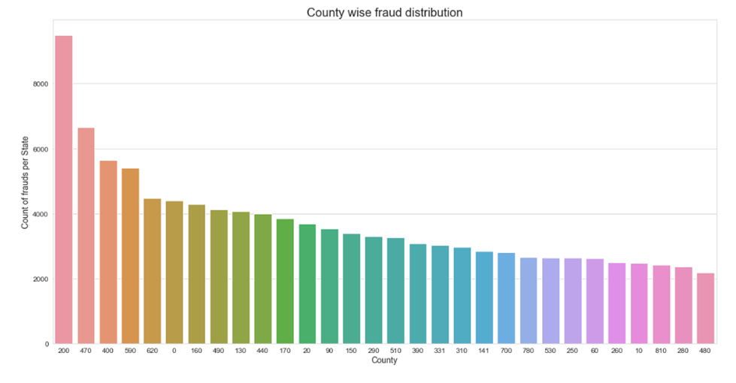
Contd..
In Patient county wise fraud distribution
Out Patient county wise fraud distribution

Slide 13
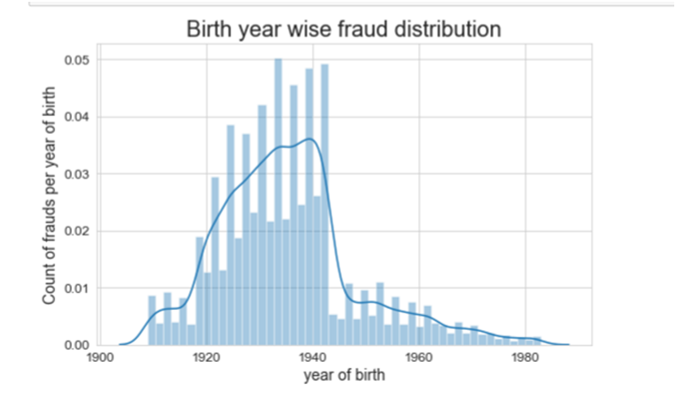
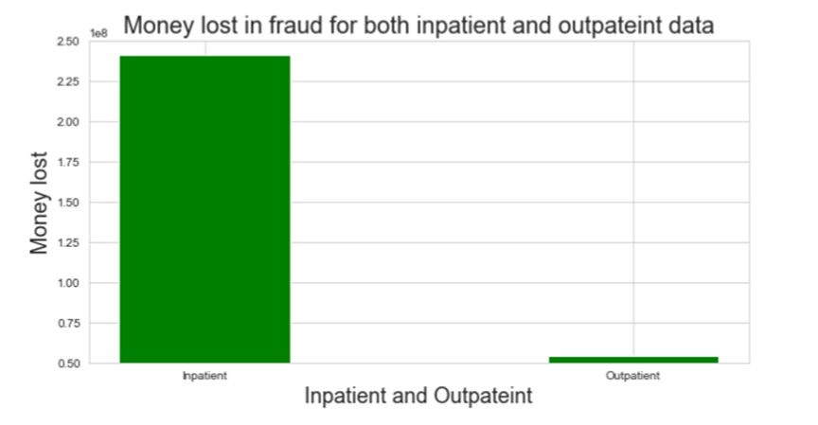
Contd..

Slide 14
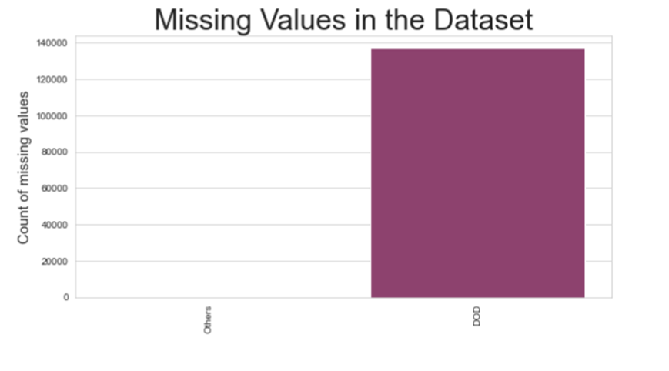
Data PRE-Processing
1) Beneficiary Dataset:
Missing value columns
DOD column has missing values

Slide 15
CONTD..
b) New Features
Patient_age
Is_dead
Patient_risk_score
c) Modifying columns values
Gender values changed from to 1 and 0 instead of 1 and 2
‘RenalDiseaseIndicator’ values changed from ‘Y’ to 1
Replacing the chronic conditions values from to 1 and 0 instead of 1 and 2

Slide 16
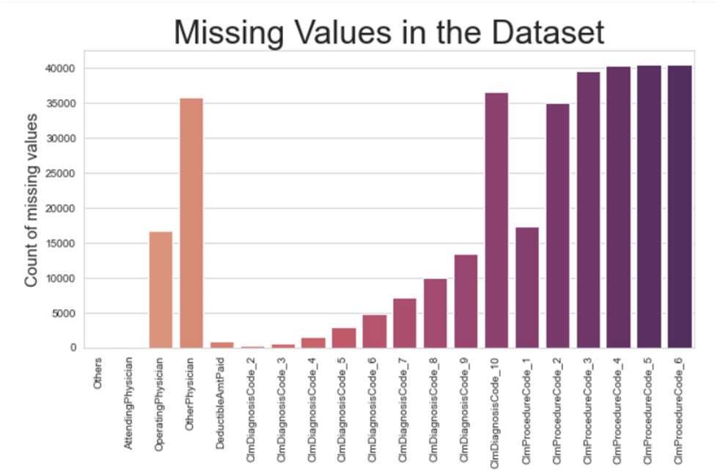
CONTD..
2) Inpatient Dataset
Missing value columns
AttendingPhysician
OperatingPhysician
OtherPhysician
DeductibleAmtPaid
ClmDiagnosisCode
ClmProcedureCode
b) New Features
Days_admitted
Claim_duration
Extra_days_claimed
Was_admitted

Slide 17
CONTD..
c) Missing values imputations
Attending Physician, Operating Physician, Other Physician having Nan values this is because of a particular beneficiary or patient have not attended by the Physician we can fill these missing values by 0
Claim Diagnose code and Claim procedure code can have Nan values because a particular code may not be applied on a patient so we can fill Nan values with 0
DeductibleAmtPaid fill with 0

Slide 18
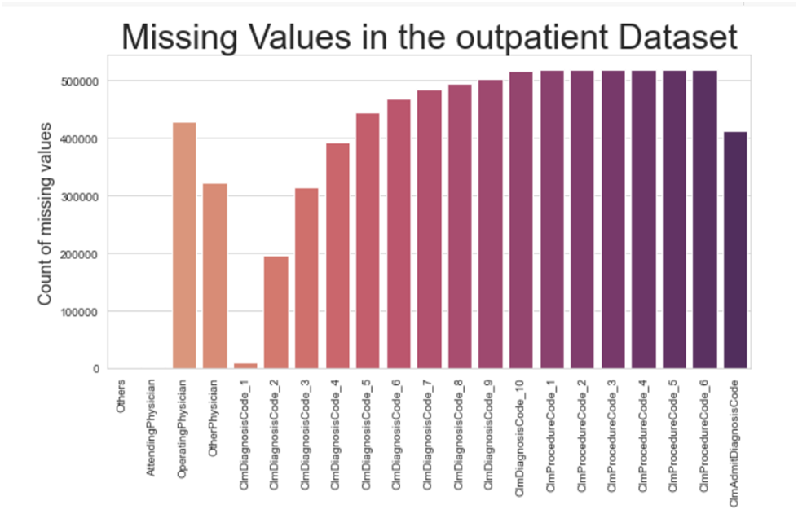
CONTD..
3) Outpatient Dataset
Missing value columns
Attending Physician
Operating Physician
Other Physician
DeductibleAmtPaid
ClmDiagnosisCodes
ClmProcedureCodes
b) New features
Was_admitted

Slide 19
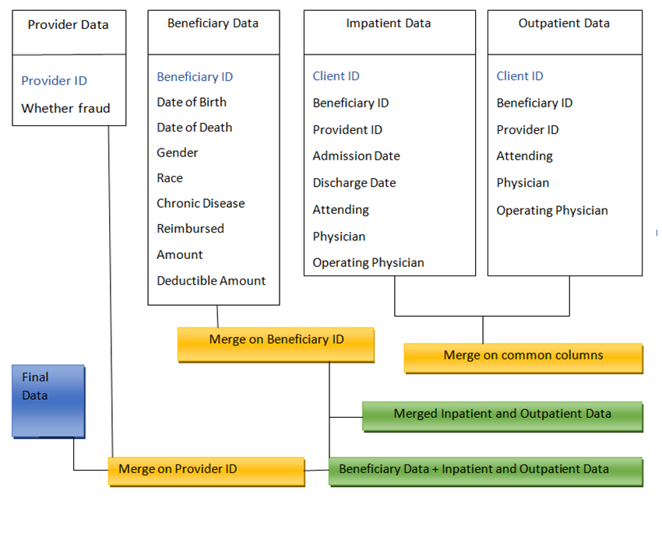
Merging all datasets
1)New features
Total_ip_op_AnnualReimbursementAmt
Total_ip_op_AnnualDeductibleAmt
Total_physicans_attended
Total_ClmDiagnosisCode
Total_ClmProcedureCode

Slide 20
Machine Learning Models
I have used the following models for my work.
Logistic Regression Model
Decision Tree Model
Random Forest Model
XG Boost
Extra Tree Classifier
ADA Boost Classifier

Slide 21
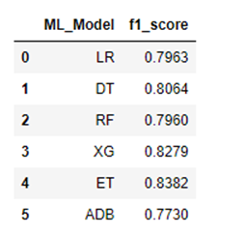
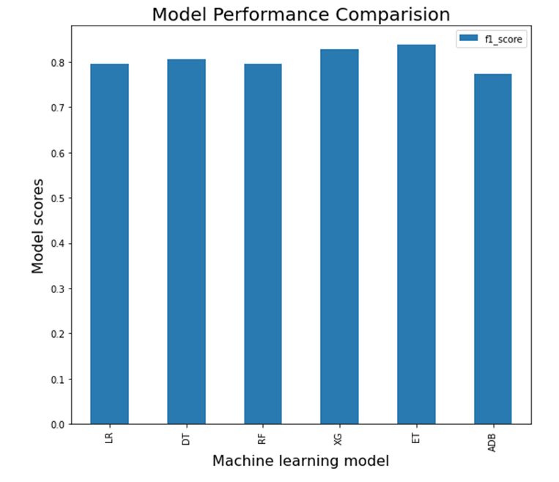
RESULTS OF ALL MODELS

Slide 22
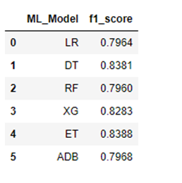
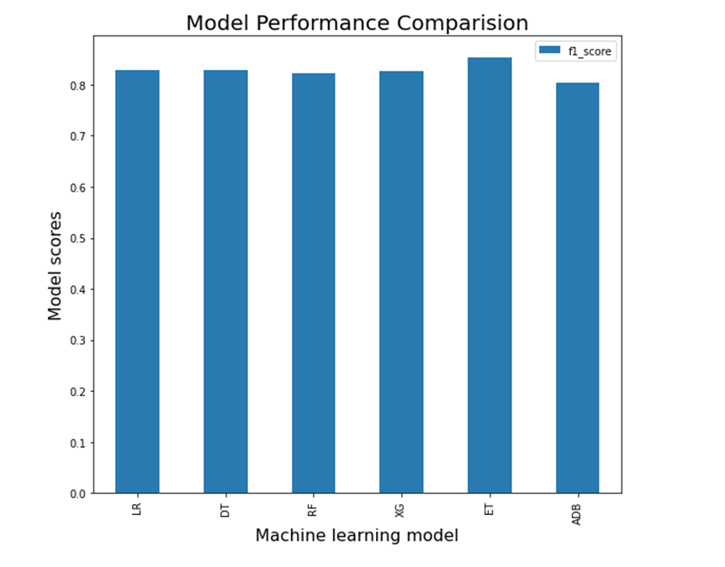
RESULTS OF HYPER TUNED MODELS

Slide 23
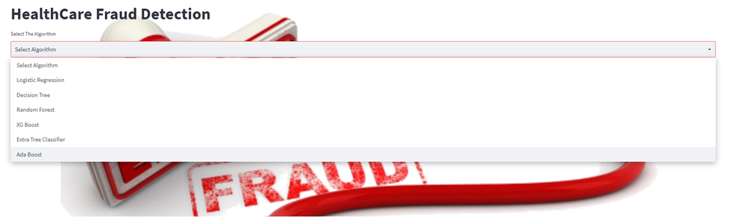
Streamlit Application

Slide 24
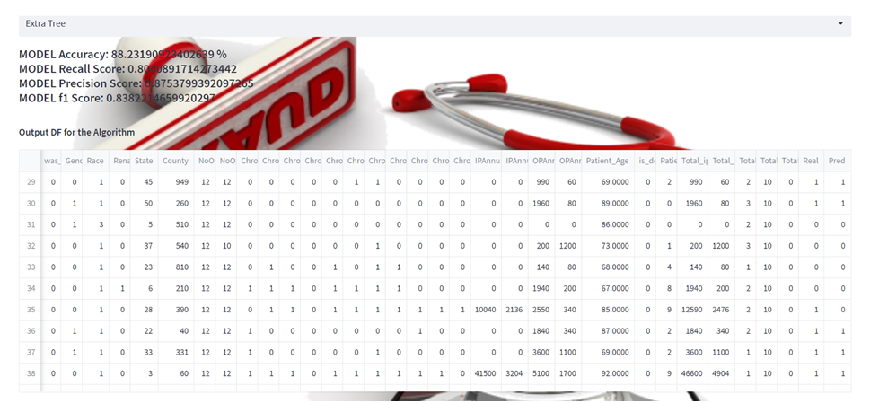
CONTD..

Slide 25
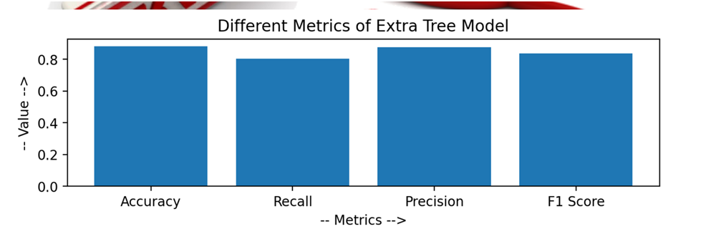
CONTD..

Slide 26
FUTURE WORK
I'll broaden my research and use deep learning to uncover fresh insights. I want to leverage dropouts and other activation methods, like Relu, to prevent over fitting. I have two choices for the top layer because this is a binary classification problem: sigmoid or SoftMax.

Slide 27
REFERENCES
https://journalofbigdata.springeropen.com/articles/10.1186/s40537-018-0138-3#Tab1
https://www.sciencedirect.com/science/article/pii/S2212017313002946
https://ieeexplore.ieee.org/abstract/document/8260744
https://www.ripublication.com/ijaer18/ijaerv13n6_140.pdf
https://www.fbi.gov/scams-and-safety/common-scams-and-crimes/health-care-fraud
https://docs.streamlit.io/library/get-started/create-an-app

Slide 28

Thank You

